Slide 1


HR Analytics - Employee Attrition Prediction
This project aims to build a machine learning model to predict employee attrition using historical data and work-related factors. Understanding attrition helps organizations retain talent and improve workforce planning. The analysis covers data exploration, preprocessing, model building, and evaluation of various classifiers.
We will explore key factors influencing attrition and apply machine learning techniques including Logistic Regression, Random Forest, XGBoost, and ensemble methods to predict whether an employee is likely to leave.
by Shubham Raut

Slide 2
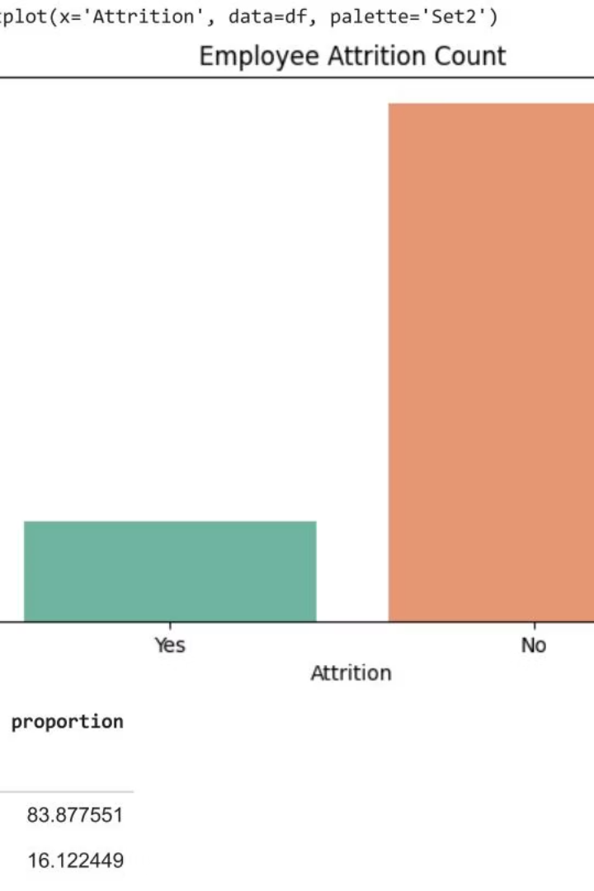
Data Exploration and Attrition Overview
Dataset Overview
Attrition Distribution
The dataset contains 1,470 records with 35 columns including employee demographics, job roles, and satisfaction metrics.
Attrition is imbalanced: 84% of employees stayed, while 16% left, highlighting the challenge of predicting minority class.
Missing Values
No missing values were found, ensuring data completeness for modeling.

Slide 3
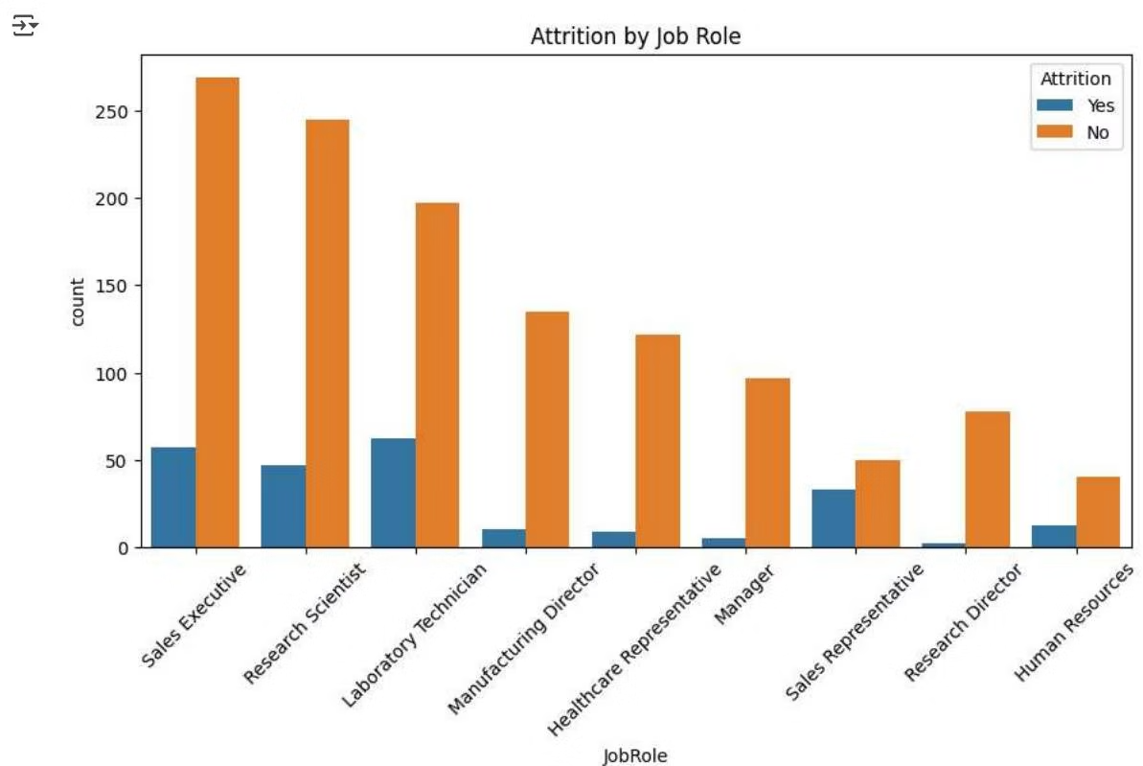
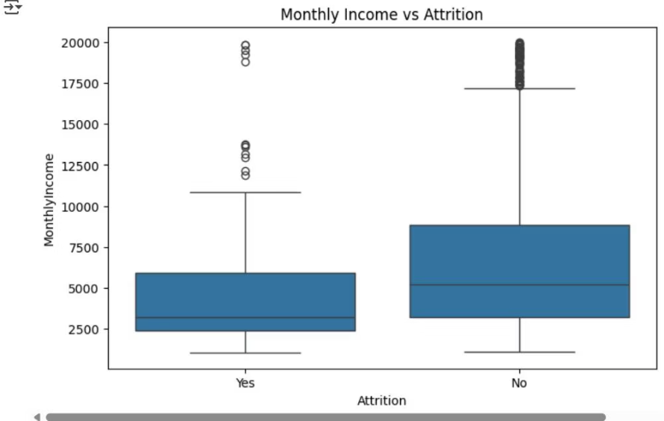
Key Factors Influencing Attrition
Job Role Impact
Monthly Income
Attrition varies significantly by job role, with higher turnover in Sales Executive, Research Scientist, and Laboratory Technician roles.
Employees who left tend to have lower monthly incomes, indicating compensation as a potential factor.

Slide 4
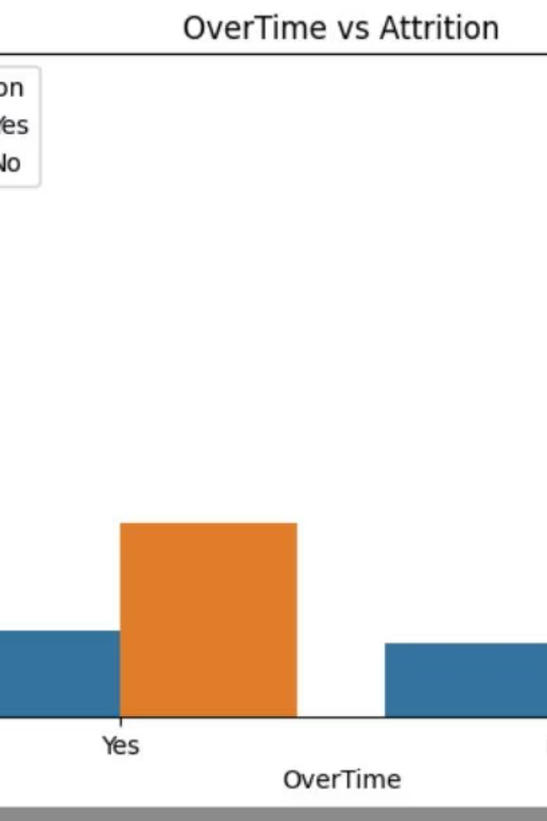
Work-Life Balance and Overtime Effects
Overtime
Job Satisfaction
Employees working overtime show higher attrition rates, suggesting work-life imbalance contributes to turnover.
Lower job satisfaction correlates with increased likelihood of leaving, emphasizing the importance of employee engagement.
Work-Life Balance
Poor work-life balance is a key driver of attrition, highlighting the need for supportive policies.

Slide 5
Data Preprocessing for Modeling
Feature Selection
Encoding
Scaling
Train-Test Split
Converted categorical variables using label encoding for binary columns and one-hot encoding for others.
Applied standard scaling to numerical features such as Age and Monthly Income for model consistency.
Data split into 80% training and 20% testing sets with stratification to maintain class balance.
Removed irrelevant columns like EmployeeNumber and StandardHours to reduce noise.

Slide 6



Model Building and Evaluation: Logistic Regression & Random Forest
Logistic Regression
Random Forest
Baseline model achieved 87% accuracy but showed low recall (30%) for attrition class, indicating difficulty detecting leavers.
Improved precision for non-attrition but recall for attrition dropped to 6%, showing challenges in minority class prediction.

Slide 7

Advanced Models: XGBoost and Ensemble Voting
XGBoost Classifier
Achieved balanced performance with 86% accuracy and better recall (26%) for attrition, outperforming previous models.
Voting Classifier
Combined Logistic Regression, Random Forest, and XGBoost using soft voting, reaching 87% accuracy and improved recall (23%) for attrition.

Slide 8

Summary and Insights
Data Understanding
Explored employee data revealing class imbalance and key attrition drivers like job role, income, and overtime.
Modeling Approach
Applied multiple classifiers with preprocessing and feature engineering to predict attrition with reasonable accuracy.
Next Steps
Improve recall for attrition class, explore additional features, and deploy model for proactive employee retention strategies.

